Slide 1
CS 202 Final Project
By: Matt Andrews, Ross peters, Jada Sheldon, Chris Glass

Slide 2


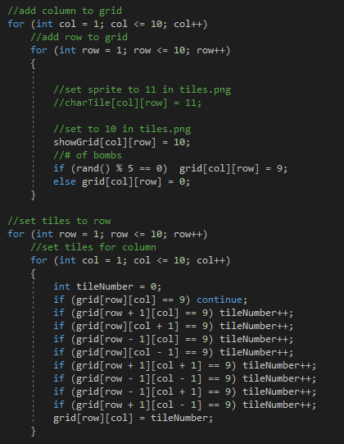

Grids
A 2D array that takes two int to make the x and y axis
int grid and int showGrid shows the size of the grid space
The for loop here adds the rows and column for the grid
This other code places the tiles images (sprits) in a random location each time the game is run.

Slide 3



Sprites
Sf::Sprite Name(texture) is the code
Sf::Texture name; and texture.loadFromFile(“Filename”) adds the texture image saved in the folder
app.draw(name) will draw the sprite that you pick
Anything can work jpeg, gif, png, Img, etc.
Gif and other animation image might have trouble with any code you use so be careful
Example of adding an image is shown on the right →

Slide 4
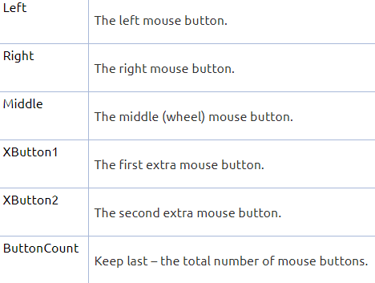

Mouse input
Main Code: sf::MouseButtonPressed
Will take any input from the mouse leftclick, rightclick, middleclick, wheel scroll, and others.
Works the same as the keyborde codes with the if the button is pressed do this type of work.
Example code on right →

Slide 5
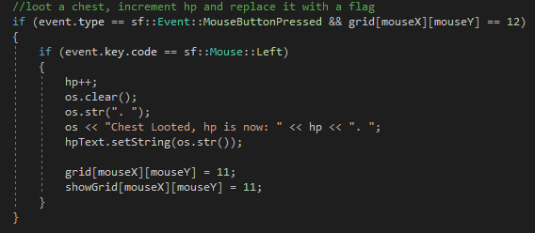
Events
Union type which means that only one of its member is active at a time
Cant use any sf::Events with out a pollEvent which comes from the sf::Window class
The event can be used with anything mousepressed, close window, entering text and many others

Slide 6
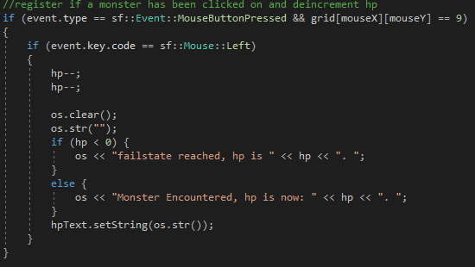
HP
Hp system was added to make the game last longer and make it into a dungeon type
Code on right shows what happen if the monster has been clicked and what it prints out
The other code shows what happen if the defeated monster chest has been clicked on

Slide 7
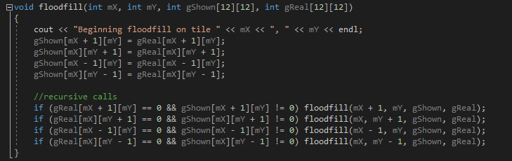
Minesweeper
Basic minesweeper gameplay
Monster replaces the bombs
Game is over with player’s hp goes to zero
Added a floodfill function to open up the spaces around the last spaced clicked if it was a black space

